Slide 1
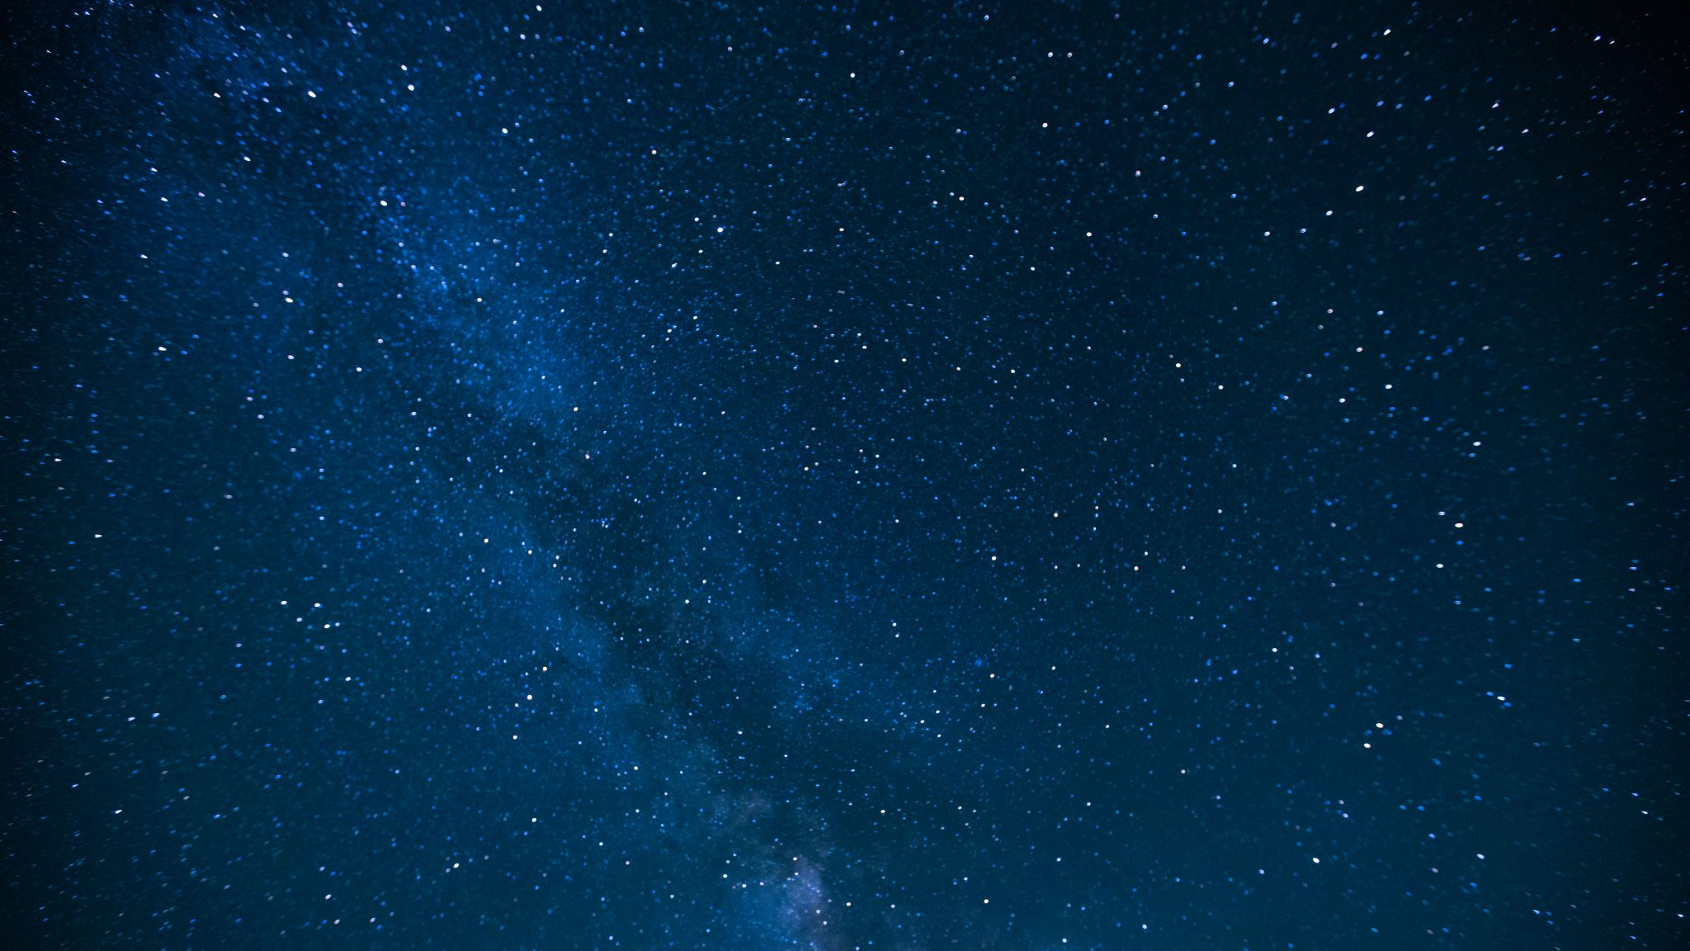
Low Frequency Gravitational wave detection
Logan Caudle
Brandon Pillon
Embry-Riddle Aeronautical University
College of Arts and Science
Mentor: Dr. Michele Zanolin
Notes:
Shannon

Slide 2
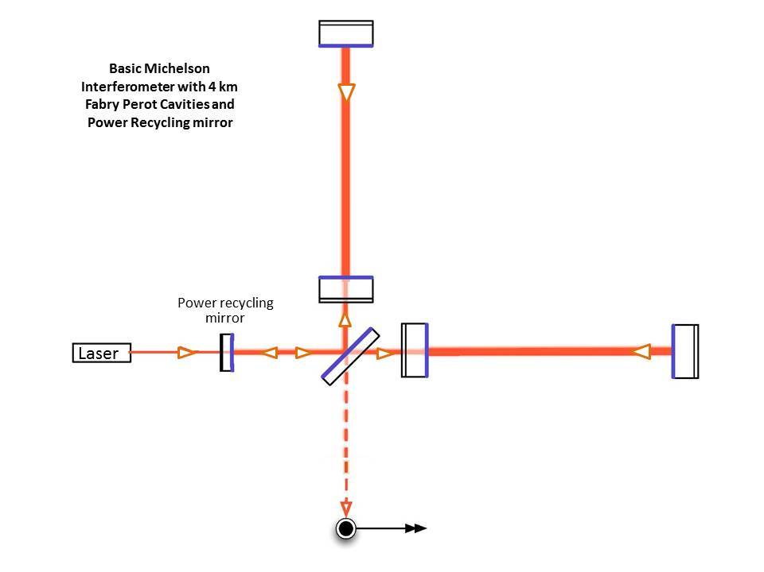
Introduction
f
Sub topic 1
Michelson-Fabry Perot Interferometer
Michelson vs Fabry Perot Interferometer
Mirrors vs long-arm length
Problems with short arms?
Noise Reduction
[1] “LIGO's Interferometer.” Caltech, https://www.ligo.caltech.edu/page/ligos-ifo.

Slide 3
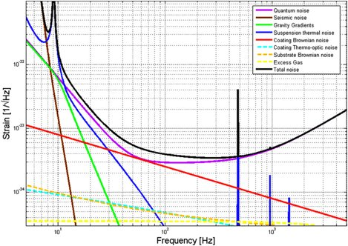
Sensitivity of LIGO
f
Sub topic 1
Noise of the LIGO interferometer
Reduce noise
Move noise out of the 10 Hz range
[2] Zhao, C., et al. “The Science Benefits of AIGO—a Southern Hemisphere Interferometric Gravitational Wave Detector.” AIP Conference Proceedings, 2010, https://doi.org/10.1063/1.3460208.

Slide 4
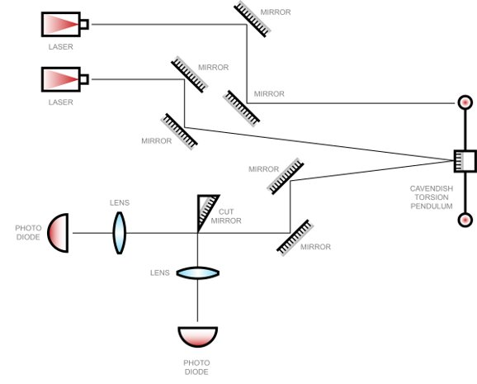
Measurment Apparatus
f
Sub topic 1
Model of LIGO Mirrors
Find natural frequency
Measure rotational movement of a Cavendish pendulum
Used to map the peak resonance

Slide 5
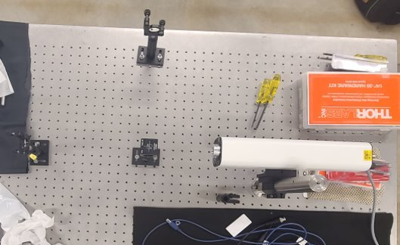
Experimental Set Up
f
Sub topic 1
Michaelson interferometer
Visualizes true size of interferometer
Vacuum chamber
Reaches 100 mTorr

Slide 6
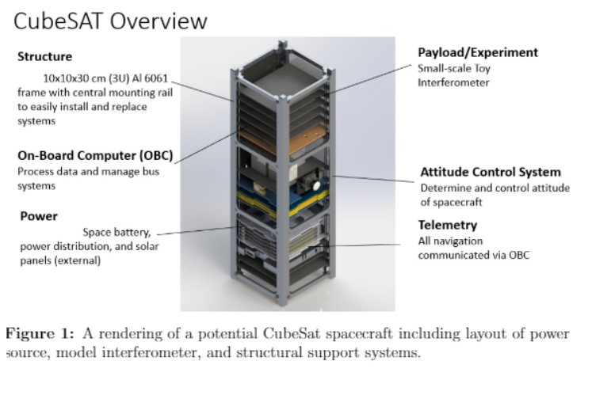
Sub topic 1
[3] Rendering of a potential CubeSat design courtesy of EagleSat

Slide 7
Future Goals
f
Sub topic 1
Create a fully functional interferometer for a payload on a CubeSat mission
Establish what interferometer will perform with the best accuracy and precision in Low Earth Orbit
Determine the feasibility of detecting gravitational waves with a small arm-length interferometer
Analyze disturbances from low earth orbit environments
Project data onto Fourier transform for frequency domain analysis

